Slide 1


Assured automation with Emulation-based Digital Twins
November 9 2024
IETF NMRG and ETSI ZSM Joint Workshop
Trinity College
Dublin
Revika Anand - r.anand@lancaster.ac.uk
Haris Charalampos Rotsos - c.rotsos@lancaster.ac.uk
Daniel King – d.king@lancaster.ac.uk
Lancaster University

Slide 2
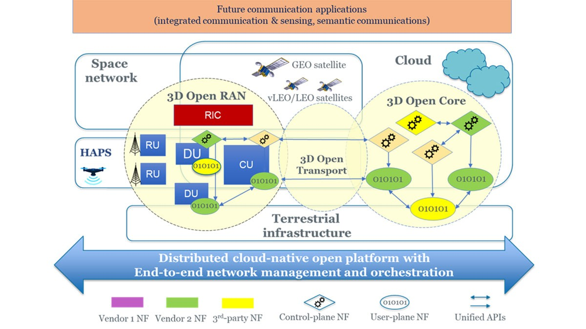
TUDOR - towards-ubiquitous-3d-open-resilient-network/our-approach

Slide 3

Automation Anxiety
Automation Correctness.
AI/ML isn’t perfect.
“Failsafe” mechanisms for unexpected failures.
Increased management responsibilities.
Model complexity.
Greater heterogeneity support increase the possibility of modeling error.
What is the best value for option Y?
Telemetry culture and automation visibility
Monitor what is available, analyse offline to built intelligence.
Are current telemetry approaches appropriate for automated E2E service management?

Slide 4
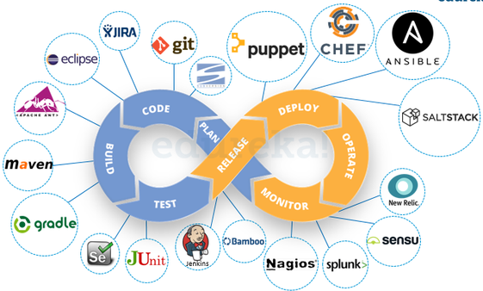
Assured Automation with Emulation
Cloud systems deploy code changes to production in hours!
Testing: Examine the artifacts and the behaviour of a software, using validation and verification.
Monitor: Collect logging information and performance counter across software layers.
Can networks adopt similar testing approaches to validate automation?
Can a NDT accurately recreate the behavior of network devices?
Testing
Non-functional
Unit
Integration
Interface
System
Regression
User-Acceptance
Installation
Reliability
Performance
Security
Load
Stress
Scalability
Volume
Functional

Slide 5
Management and Orchestration for 3D Open Networks
New management approaches required for 3D Open Networks.
Multi-technology, multi-domain, dynamic infrastructure, adaptation during operation
Intent-based networking.
Decouple network configuration from requirements
Easy addition of intelligence
Improve automation
Challenges:
Heterogeneity
Cover both deployment and operation
Built-in correctness validation

Slide 6
Key Technical Achievements Closed-control automation for 3D Open Networks
Life-cycle automation for intent-based management in 3D Open Networks.
Use-case: Automated slice provision with bandwidth (BR 2.2a) and priority (BR 2.2b) management.
Multi-domain monitoring.
Multi-domain monitoring architecture.
Lightweight active measurement probes (BR 2.2c).

Slide 7
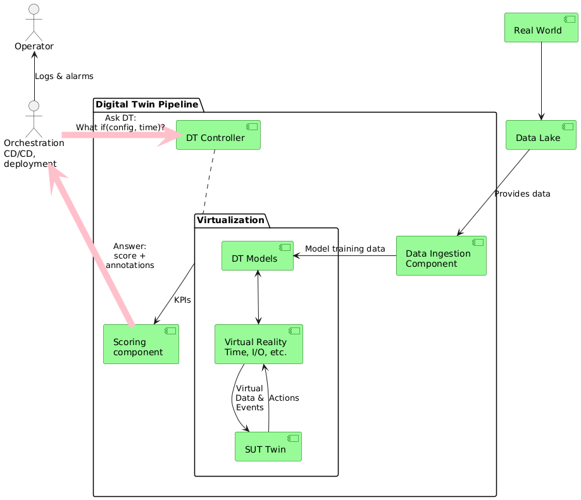
3D Open Digital Twin
A digital model of a physical system that replicates realistically behaviors.
TUDOR implements two DT systems to scope modeling: RAN and Core.
Use-cases: Validation, Prediction, ML training
Challenges:
Monitoring & Telemetry
Implementation maturity
Integration with management mechanisms
TUDOR Digital Twin system architecture.

Slide 8
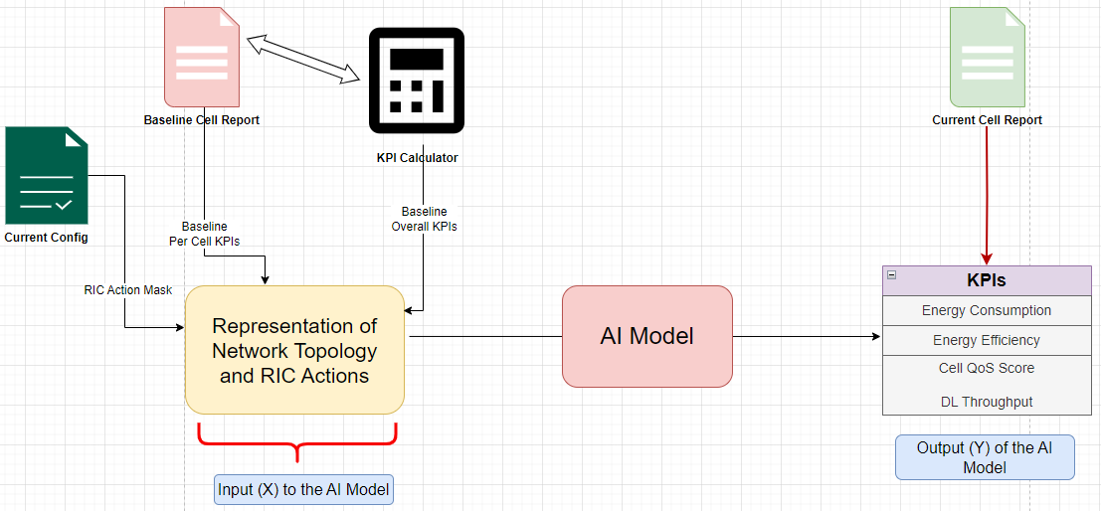
Key Technical Achievements Digital Twin Platform
3D Open RAN DT
RAN energy optimization
Predict power consumption of different xAPPs.
3D Open Core DT
Validate configuration correctness.
Use CI/CD pipeline to automated testing.
3D Open Core DT: CI/CD configuration validation (BR 2.1b)
3D Open RAN DT: CI/CD configuration validation (BR2.1a)

Slide 9

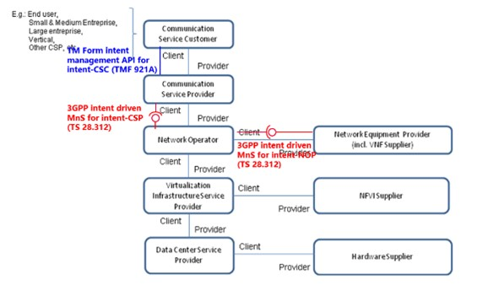
3GPP Compatibility
TUDOR IBN Architecture
TS 28.312: "Management and orchestration; Intent driven management services for mobile networks".

Slide 10
Use-case: Intent Validation

Slide 11
NDT Life-cycle model
Node, network and script actions get associated event tags
e.g. , “node created”
Test life-cycle architecture: model node interactions using event tags
Global event ordering in a test scenario
Easy identification of parallelizable interactions
Start Node 1
Test Connection
[script “con”]
Start Node 2
Day 1 Config
[Node 2]
Traffic Gen
[Script “tg”]
Stop Node 2
Start Node 4
Test Bandwidth
[script “bw”]
Start Node 3

Slide 12
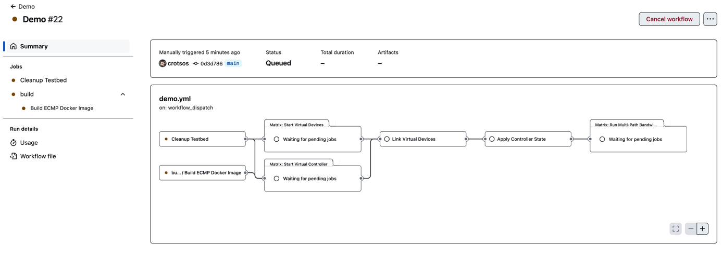
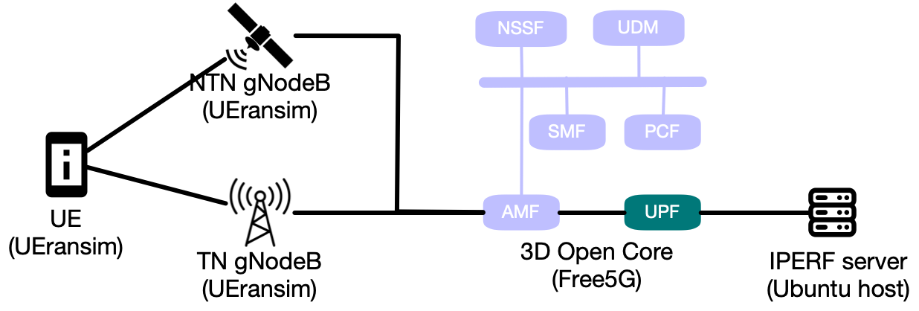
3D Open Core DT Use-case

Slide 13
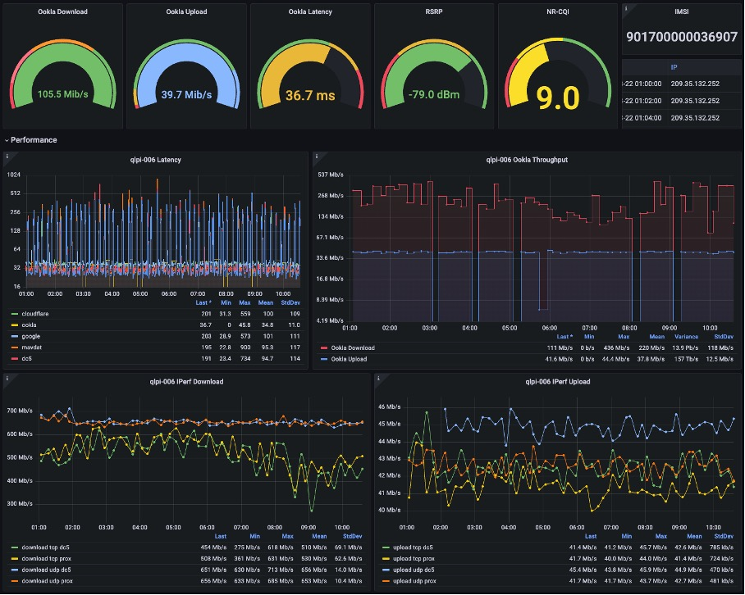
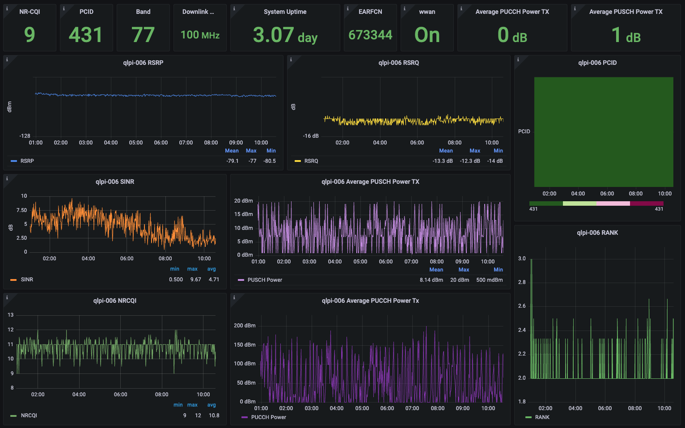
Monitoring in action

Slide 14
Next Steps
Complete intent use-case
Run-time slice adaptation
Use Core DT to verify configuration
Intent-driven uniprobe monitoring services
Intent Handler Evaluation
Scalability, incl. monitoring¯
Responsiveness
Generality
DT Evaluation
Scalability
Accuracy
Energy Efficiency

Slide 15
SDO Opportunity?
Emulation technologies offer a great opportunity to develop high-precision DT models.
Use cases: integration testing, automation plan validation, CI for networks.
NES is a flexible Emulation-based DT
Full test lifecycle support (setup and test)
Model-driver test specification and test scripting language
Integrates diverse emulation technologies in a single topology
Standardization opportunity: Can we define a generic model for test automation
Allow network community to share best practices via regression tests for configuration.

Slide 16
SDO Opportunity Work
Define a standard model for test descriptions
Capture both topology and test activities
Allow easy integration with different processes, e.g., validate human or AI/ML configuration, security policy conformance.
Lots of topology models
Mininet, Docker compose, NFV-MAN, SIMAP?
Test modeling is more complex
Ansible cookbooks, Juju charms, TMForum ODA
Opportunity: Community network test suites
Allow users to exchange test suites for configuration
A repeatable test suite is used for consistent validation configuration updates.
Exchange best practices between vendors and operators.

Slide 17
Backup Slides
Path Observation
Intent Handler
Intent Reasoner
TUDOR Ontology
TUDOR Slice Example

Slide 18
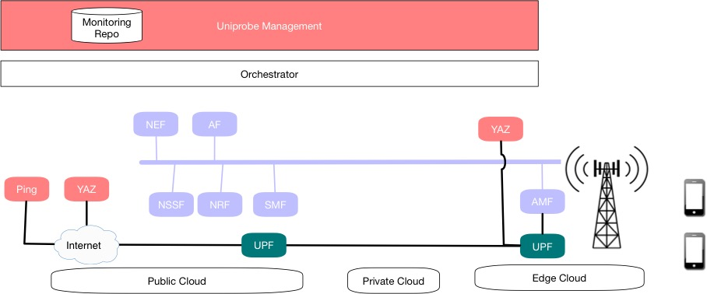
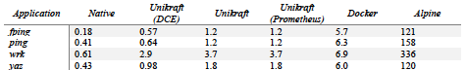
Uniprobe in action
Operate using OSM and OpenStack.
Embedded monitoring adaptor for the TUDOR monitoring subsystem.
Supported apps
YAZ, ping, iperf, trace route, wrk
Can operate with 64 Mb and 1 vCPU.

Slide 19
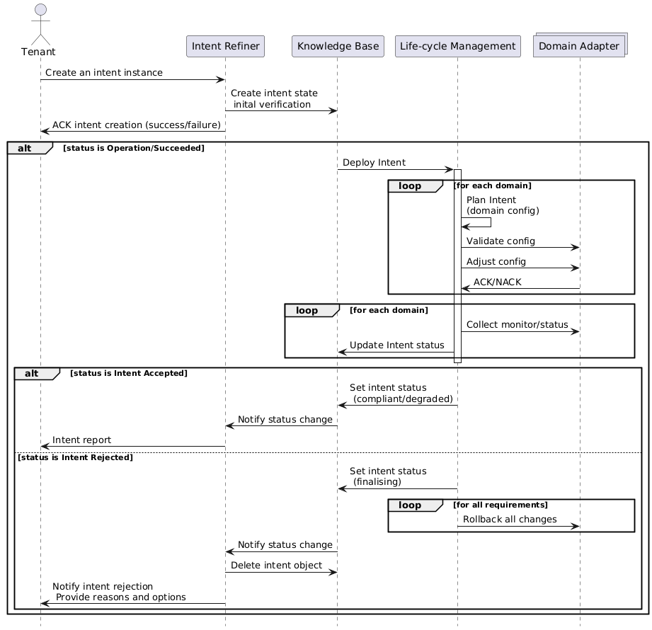
Intent Handler Architecture

Slide 20
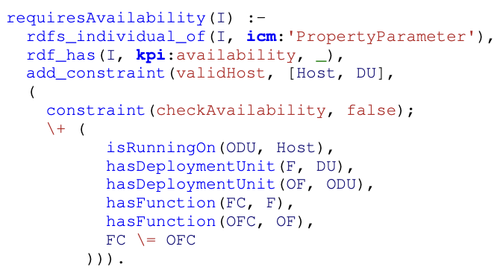
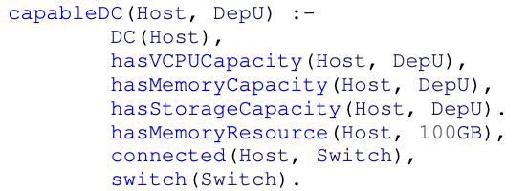
Oz semantic reasoner

Slide 21
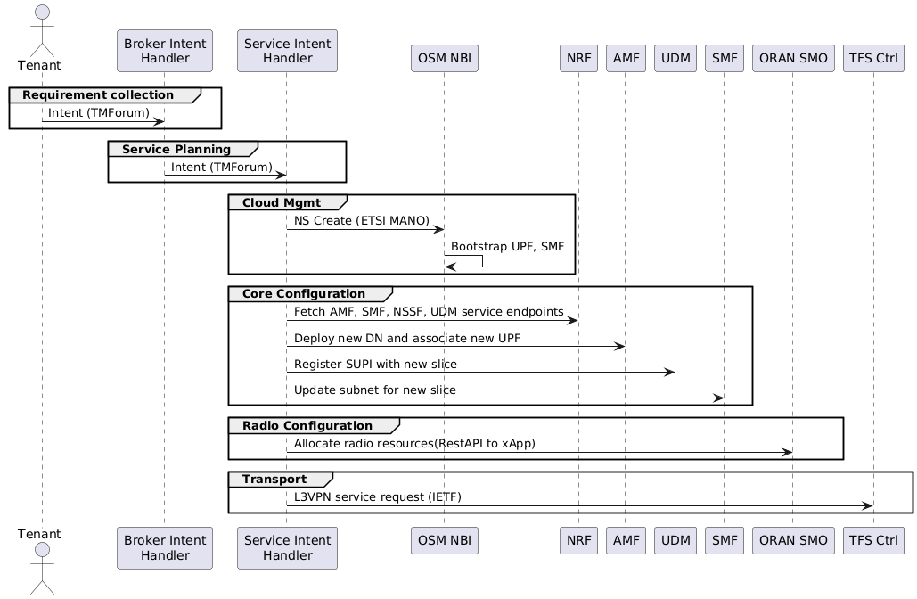
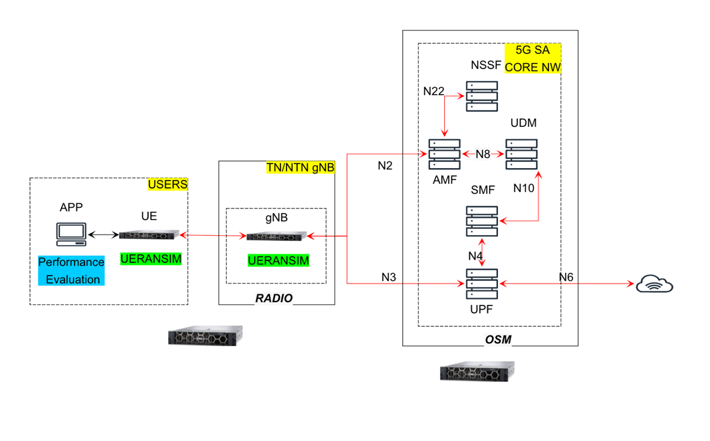
Use-case: Slice deployment

Slide 22
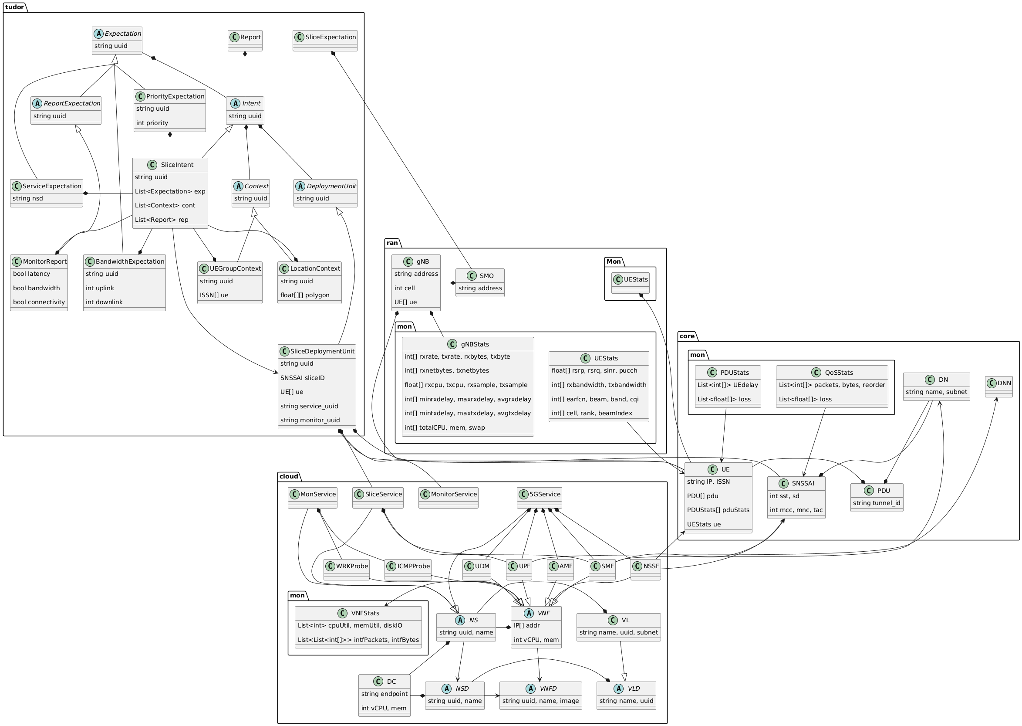
TUDOR Ontology

Slide 23
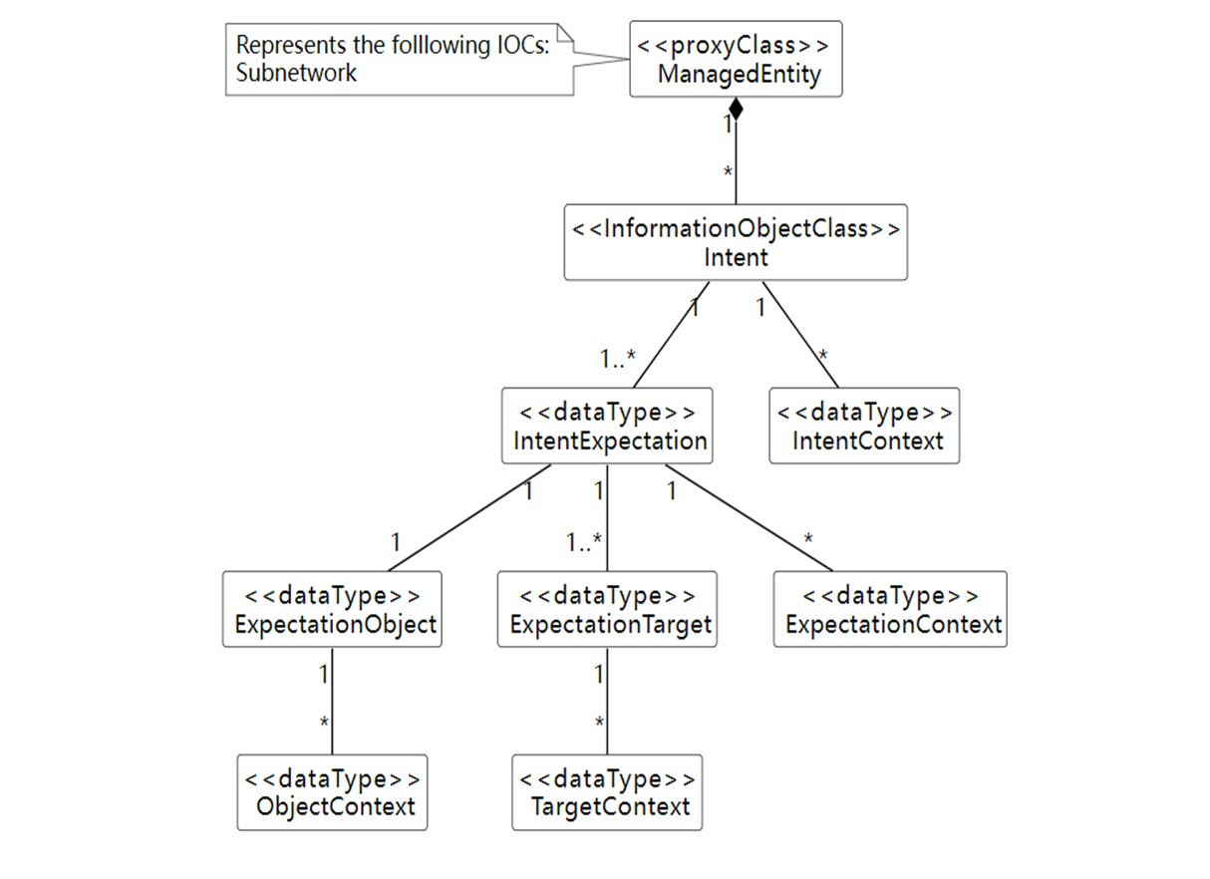
3GPP Intent model

